Slide 1
Course Outline
Process Management
Concurrent Process
More later

Slide 2
Course Assessment
Quiz/Homework: 10%
Midterm: 30%
Final: 30%
Programming Project: 30%

Slide 3
Process Management

Slide 4
Learning Objectives
After completing this chapter, you should be able to describe:
The differences among deadlock, race, and starvation
Several causes of system deadlock and livelock
The difference between preventing and avoiding deadlocks
How to detect and recover from deadlocks
How to detect and recover from starvation
The concept of a race and how to prevent it

Slide 5

Introduction
Deadlock. What is it?

Slide 6

Introduction
Deadlock. What is it?

Slide 7
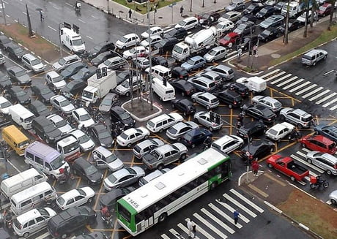
Introduction
Deadlock. What is it?

Slide 8
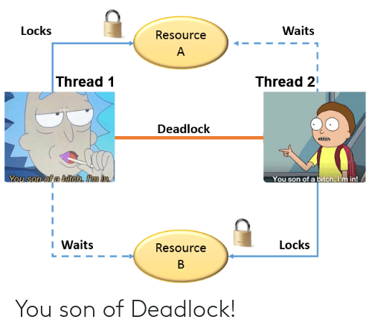
Introduction
Deadlock. What is it?

Slide 9
Introduction
Resource sharing perspectives
Memory management and processor sharing
Many programs competing for limited resources
Lack of process synchronization consequences
Deadlock: “deadly embrace,” “Catch 22,” “blue screen of death,” etc.
Two or more jobs placed in HOLD state
Jobs waiting for unavailable vital resource
System comes to standstill
Unresolved by OS: requires external intervention

Slide 10
Deadlock, Livelock, and Starvation
Narrow staircase analogy
Staircase = system; steps and landings = resources
Stairs: only wide enough for one person
Landing at each floor: room for two people
Deadlock: two people meet on the stairs
Neither retreats
Livelock: two people on a landing
Each time one takes a step to the side, the other mirrors that step; neither moves forward
Starvation: people wait on landing for a break
Break never comes

Slide 11
Deadlock
More serious than starvation
Affects entire system
Affects more than one job
Not just a few programs
All system resources become unavailable
More prevalent in interactive systems
Real-time systems
Deadlocks quickly become critical situations
OS must prevent or resolve

Slide 12
Seven Cases of Deadlock or Livelock
Nonsharable/nonpreemptable resources
Allocated to jobs requiring same type of resources
Resource types locked by competing jobs
File requests
Databases
Dedicated device allocation
Multiple device allocation
Spooling
Network
Disk sharing

Slide 13
Case 1: Deadlocks on File Requests
Jobs request and hold files for execution duration
Example (Figure 5.2)
Two programs (P1, P2) and two files (F1, F2)
Deadlock sequence
P1 has access to F1 and also requires F2
P2 has access to F2 and also requires F1
Deadlock remains until:
One program is closed or
One program is forcibly removed and file is released
Other programs requiring F1 or F2
Put on hold for duration of situation

Slide 14
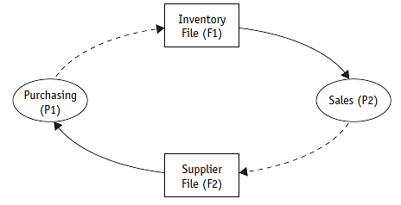
Case 1: Deadlocks on File Requests (cont'd.)
(figure 5.2)
Case 1. These two processes, shown as circles, are each waiting for a resource, shown as rectangles, that has already been allocated to the other process, thus creating a deadlock. © Cengage Learning 2014

Slide 15
Case 2: Deadlocks in Databases
Two processes access and lock database records
Locking
Guarantees data integrity
One user locks out all other database users
Three locking levels
Entire database for duration of request
Subsection of database
Individual record until request completed

Slide 16
Case 2: Deadlocks in Databases (cont'd.)
Example: two processes (P1 and P2)
Each needs to update two records (R1 and R2)
Deadlock sequence
P1 accesses R1 and locks it
P2 accesses R2 and locks it
P1 requests R2 but locked by P2
P2 requests R1 but locked by P1
Race between processes
Results when locking not used
Causes incorrect final version of data
Depends on process execution order

Slide 17
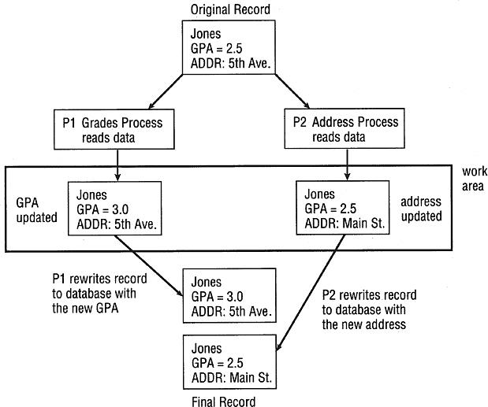
Case 2: Deadlocks in Databases (cont'd.)
(figure 5.3)
Case 2. P1 finishes first and wins the race but its version of the record will soon be overwritten by P2. Regardless of which
process wins the race, the final version of the data will be incorrect. © Cengage Learning 2014

Slide 18
Case 3: Deadlocks in Dedicated Device Allocation
Limited number of dedicated devices
Example
Two administrators each running education programs with processes P1 and P2, respectively
Need two audio recorders each
Only two audio recorders (R1 and R2) available
Deadlock sequence
P1 requests tape R1 and gets it
P2 requests tape R2 and gets it
P1 requests tape R2 but blocked
P2 requests tape R1 but blocked

Slide 19
Case 4: Deadlocks in Multiple Device Allocation
Several processes request & hold dedicated devices
Example (Figure 5.4)
Three programs (P1, P2, P3)
Three dedicated devices (scanner, printer, plotter)
Deadlock sequence
P1 requests and gets scanner
P2 requests and gets printer
P3 requests and gets the plotter
P1 requests printer but blocked
P2 requests plotter but blocked
P3 requests scanner but blocked

Slide 20
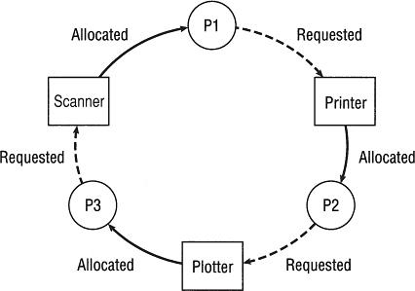
Case 4: Deadlocks in Multiple Device Allocation (cont'd.)
(figure 5.4)
Case 4. Three processes,
shown as circles, are each waiting for a device that has already been allocated to another process, thus creating a deadlock. © Cengage Learning 2014

Slide 21
Case 5: Deadlocks in Spooling
Virtual device
Dedicated device made sharable
Example
Printer: high-speed disk device transfers data between printer and CPU
Spooling
Process
Spooler accepts output from several users
Acts as temporary storage for output
Output resides in spooling system until printer accepts job data

Slide 22
Case 5: Deadlocks in Spooling (cont'd.)
Deadlock sequence
Printer needs all job output before printing begins
Spooling system fills disk space area
No one job has entire print output in spool area
Results in partially completed output for all jobs
Results in deadlock

Slide 23
Case 6: Deadlocks in a Network
No network protocols controlling network message flow
Example (Figure 5.5)
Seven computing devices on network
Each on different nodes
Direction of arrows
Indicates communication flow
Deadlock sequence
All available buffer space fills

Slide 24
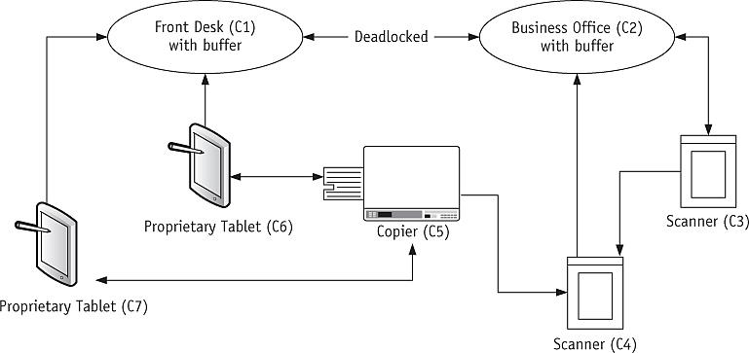
Case 6: Deadlocks in a Network (cont'd.)
(figure 5.5)
Case 6, deadlocked network flow. Notice that only two nodes, C1 and C2, have buffers. Each line represents a communication path. The arrows indicate the direction of data flow. © Cengage Learning 2014

Slide 25
Case 7: Deadlocks in Disk Sharing
Competing processes send conflicting commands
Scenario: disk access resulting in livelock
Example (Figure 5.6)
Two processes
Each process waiting for I/O request
One at Track 20 and one at Track 310
Deadlock sequence
Arm moves back and forth between Tracks 20 and 310 attempting to fulfill the two competing commands
Neither I/O request is satisfied

Slide 26
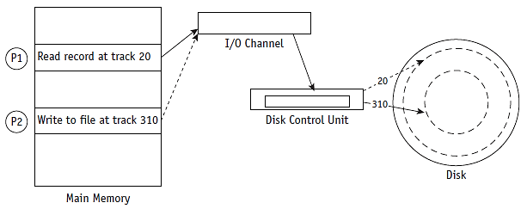
Case 7: Deadlocks in Disk Sharing (cont'd.)
(figure 5.6)
Case 7. Two processes are each waiting for an I/O request to be filled: one at
track 20 and one at track 310. But by the time the read/write arm reaches one track, a competing command for the other track has been issued, so neither command is satisfied and livelock occurs. © Cengage Learning 2014

Slide 27
Necessary Conditions for Deadlock or Livelock
Four conditions required for a locked system
Mutual exclusion: allowing only one process access to dedicated resource
Resource holding: not releasing the resource; waiting for other job to retreat
No preemption: lack of temporary reallocation of resources
Circular wait: each process waiting for another to voluntarily release so at least one can continue
All conditions required for deadlock

Slide 28
Necessary Conditions for Deadlock or Livelock (cont'd.)
Resolving deadlock: remove one of the conditions
All four conditions prevented simultaneously ► deadlock prevented
Difficult to implement

Slide 29
Modeling Deadlocks
Directed graphs: Richard Holt (1972)
Circles represent processes
Squares represent resources
Solid line with arrow from resource to process
Process holding resource
Dashed line with arrow from a process to resource
Process waiting for resource
Arrow direction indicates flow
Cycle in graph
Deadlock involving processes and resources

Slide 30
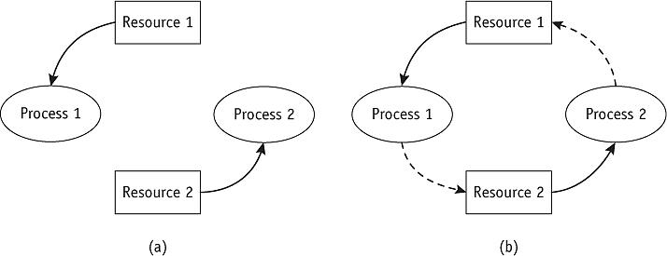
Modeling Deadlocks (cont'd.)
(figure 5.7)
In (a), Resource 1 is being held by Process 1 and Resource 2 is held by Process 2 in a system that is not deadlocked. In (b), Process 1 requests Resource 2 but doesn’t release Resource 1, and Process 2 does the same— creating a deadlock. (If one process released its resource, the deadlock would be resolved.) © Cengage Learning 2014

Slide 31
Modeling Deadlocks (cont'd.)
Three graph scenarios to help detect deadlocks
System has three processes (P1, P2, P3)
System has three resources (R1, R2, R3)
Scenario one: no deadlock
Resources released before next process request
Scenario two: deadlock
Processes waiting for resource held by another
Scenario three: no deadlock
Resources released before deadlock

Slide 32
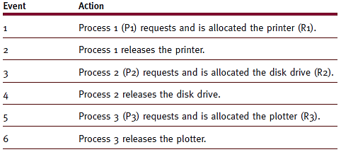
Modeling Deadlocks (cont'd.)
No deadlock
Resources released before next process request
(table 5.1)
Scenario 1. These events are shown in the directed graph in Figure 5.8. © Cengage Learning 2014

Slide 33
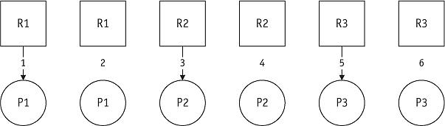
Modeling Deadlocks (cont'd.)
(figure 5.8)
First scenario. The system will stay free of deadlocks if each resource is released before it is requested by the next process. © Cengage Learning 2014

Slide 34
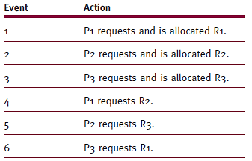
Modeling Deadlocks (cont'd.)
Deadlock
Processes waiting for resource held by another
(table 5.2)
Scenario 2. This sequence of events is shown in the two directed graphs shown in Figure 5.9. © Cengage Learning 2014

Slide 35
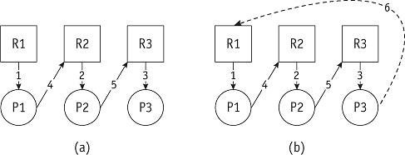
Modeling Deadlocks (cont'd.)
(figure 5.9)
Second scenario. The system (a) becomes deadlocked (b) when P3 requests R1. Notice the circular wait. © Cengage Learning 2014

Slide 36
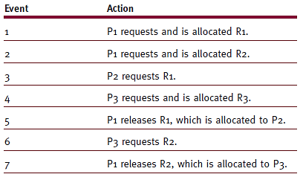
Modeling Deadlocks (cont'd.)
No deadlock
Resources released before deadlock
(table 5.3)
Scenario 3. This sequence of events is shown in the directed graph in Figure 5.10. © Cengage Learning 2014

Slide 37
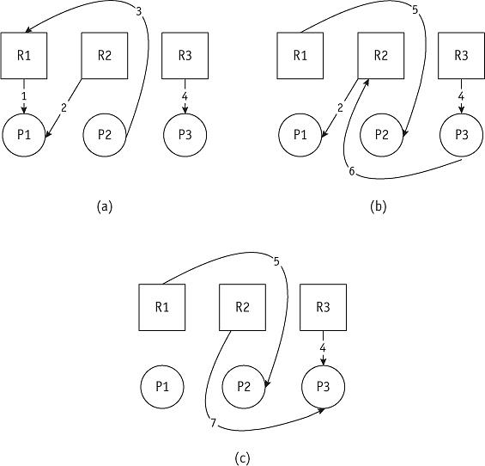
Modeling Deadlocks (cont'd.)
(figure 5.10)
The third scenario. After event 4, the directed graph looks like (a) and P2 is blocked because P1 is holding on to R1. However, event 5 breaks the deadlock and the graph soon looks like (b). Again there is a blocked process, P3, which must wait for the release of R2 in event 7 when the graph looks like (c). © Cengage Learning 2014

Slide 38
Modeling Deadlocks (cont'd.)
Another example
Resources of same type
Allocated individually or grouped in same process
Graph clusters devices into one entity
Allocated individually or grouped in different process
Graph clusters devices into one entity

Slide 39
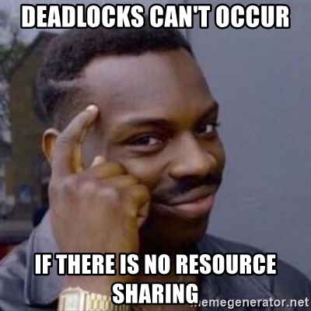
Strategies for Handling Deadlocks

Slide 40
Strategies for Handling Deadlocks
Prevention
Prevent occurrence of one condition
Mutual exclusion, resource holding, no preemption, circular wait
Avoidance
Avoid deadlock if it becomes probable
Detection
Detect deadlock when it occurs
Recovery
Resume system normalcy quickly and gracefully

Slide 41
Strategies for Handling Deadlocks (cont'd.)
Prevention eliminates one of four conditions
Complication: same condition cannot be eliminated from every resource
Mutual exclusion
Some resources must allocate exclusively
Bypassed if I/O device uses spooling
Resource holding
Bypassed if jobs request every necessary resource at creation time
Multiprogramming degree significantly decreased
Idle peripheral devices

Slide 42
Strategies for Handling Deadlocks (cont'd.)
Prevention (cont'd.)
No preemption
Bypassed if operating system allowed to deallocate resources from jobs
Okay if job state easily saved and restored
Preempting dedicated I/O device or files during modification: extremely unpleasant recovery tasks
Circular wait
Bypassed if operating system prevents circle formation
Uses hierarchical ordering scheme
Requires jobs to anticipate resource request order
Difficult to satisfy all users

Slide 43
Strategies for Handling Deadlocks (cont'd.)
Avoidance: use if condition cannot be removed
System knows ahead of time
Sequence of requests associated with each active process
Dijkstra’s Bankers Algorithm (Dijkstra, 1965)
Regulates resource allocation to avoid deadlocks
No customer granted loan exceeding bank’s total capital
All customers given maximum credit limit
No customer allowed to borrow over limit
Sum of all loans will not exceed bank’s total capital

Slide 44
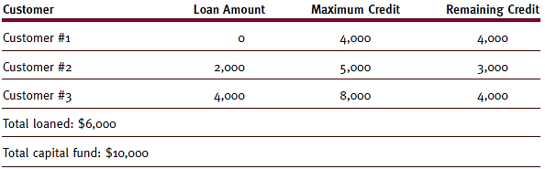
Strategies for Handling Deadlocks (cont'd.)
(table 5.4)
The bank started with $10,000 and has remaining capital of $4,000 after these loans. Therefore, it’s in a “safe state.” © Cengage Learning 2014

Slide 45
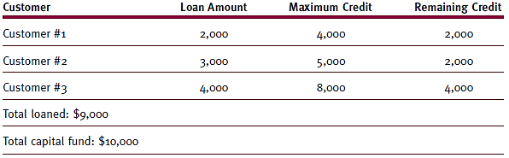
Strategies for Handling Deadlocks (cont'd.)
(table 5.5)
The bank only has remaining capital of $1,000 after these loans and therefore is in an “unsafe state.” © Cengage Learning 2014

Slide 46
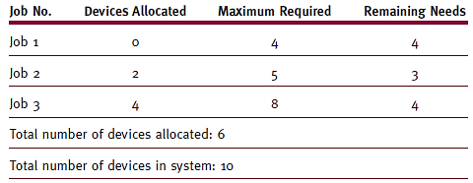
Strategies for Handling Deadlocks (cont'd.)
(table 5.6)
Resource assignments after initial allocations. This is a safe state: Six devices are allocated and four units are still available. © Cengage Learning 2014

Slide 47
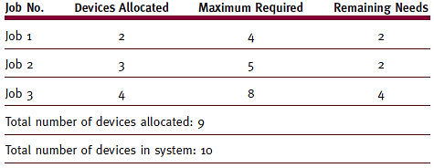
Strategies for Handling Deadlocks (cont'd.)
(table 5.7)
Resource assignments after later allocations. This is an unsafe state: Only one unit is available but every job requires at least two to complete its execution. © Cengage Learning 2014

Slide 48
Strategies for Handling Deadlocks (cont'd.)
Operating systems deadlock avoidance assurances
Never satisfy request if job state moves from safe to unsafe
Identify job with smallest number of remaining resources
Number of available resources >= number needed for selected job to complete
Block request jeopardizing safe state

Slide 49
Strategies for Handling Deadlocks (cont'd.)
Problems with the Banker’s Algorithm
Jobs must state maximum number needed resources
Requires constant number of total resources for each class
Number of jobs must remain fixed
Possible high overhead cost incurred
Resources not well utilized
Algorithm assumes worst case
Scheduling suffers
Result of poor utilization
Jobs kept waiting for resource allocation

Slide 50
Strategies for Handling Deadlocks (cont'd.)
Detection: build directed resource graphs
Look for cycles
Algorithm detecting circularity
Executed whenever appropriate
Detection algorithm
Remove process using current resource and not waiting for one
Remove process waiting for one resource class
Not fully allocated
Go back to step 1
Repeat steps 1 and 2 until all connecting lines removed

Slide 51
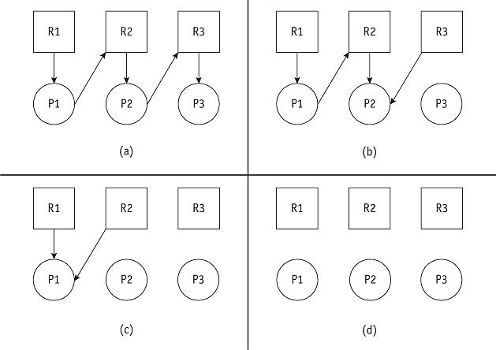
Strategies for Handling Deadlocks (cont'd.)
(figure 5.11)
This system is deadlock-free because the graph can be completely reduced, as shown in (d). © Cengage Learning 2014

Slide 52
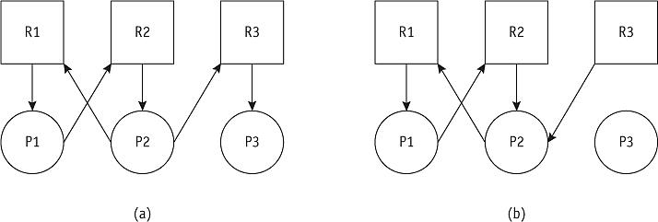
Strategies for Handling Deadlocks (cont'd.)
(figure 5.12)
Even after this graph (a) is reduced as much as possible (by removing the request from P3), it is still deadlocked (b). © Cengage Learning 2014

Slide 53
Strategies for Handling Deadlocks (cont'd.)
Recovery
Deadlock untangled once detected
System returns to normal quickly
Nearly all recovery methods have at least one victim
Recovery methods
Terminate every job active in system
Restart jobs from beginning
Terminate only jobs involved in deadlock
Ask users to resubmit jobs
Identify jobs involved in deadlock
Terminate jobs one at a time

Slide 54
Strategies for Handling Deadlocks (cont'd.)
Recovery methods (cont'd.)
Interrupt jobs with record (snapshot) of progress
Select nondeadlocked job
Preempt its resources
Allocate resources to deadlocked process
Stop new jobs from entering system
Allow nondeadlocked jobs to complete
Releases resources when complete
No victim

Slide 55
Strategies for Handling Deadlocks (cont'd.)
Factors to consider
Select victim with least-negative effect on the system
Most common
Job priority under consideration: high-priority jobs usually untouched
CPU time used by job: jobs close to completion usually left alone
Number of other jobs affected if job selected as victim
Jobs modifying data: usually not selected for termination (a database issue)

Slide 56
Starvation
Job execution prevented
Waiting for resources that never become available
Results from conservative resource allocation
Example
Dining Philosophers Problem (Dijkstra, 1968)
Starvation avoidance
Implement algorithm tracking how long each job has been waiting for resources (aging)
Starvation detected: block new jobs until starving jobs satisfied

Slide 57
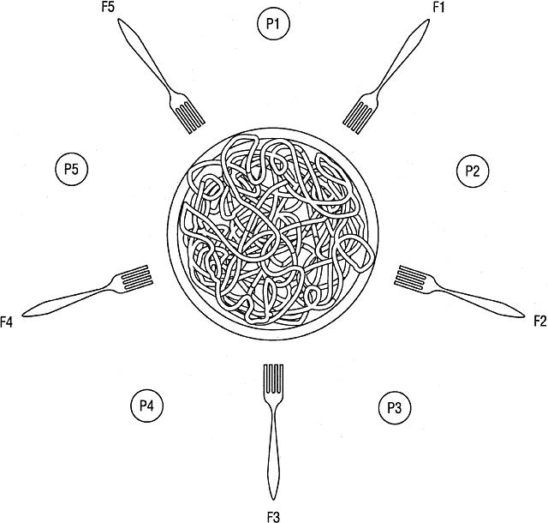
Starvation (cont'd.)
(figure 5.13)
The dining philosophers’ table, before the meal begins. © Cengage Learning 2014

Slide 58
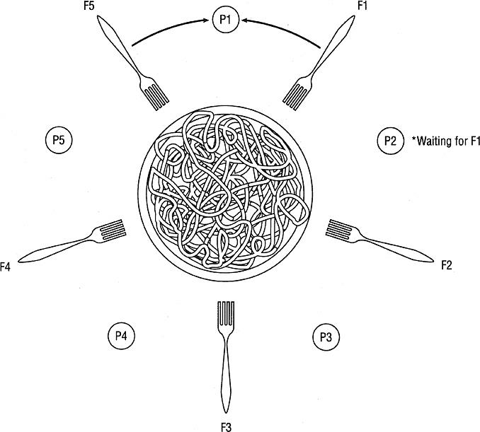
Starvation (cont'd.)
(figure 5.14)
Each philosopher must have both forks to begin eating, the one on the right and the one on the left. Unless the resources, the forks, are allocated fairly, some philosophers may starve. © Cengage Learning 2014

Slide 59
Conclusion
Operating systems
Must dynamically allocate resources while avoiding deadlock and starvation
Four methods for dealing with deadlocks
Prevention, avoidance, detection, and recovery
Prevention
Remove simultaneous occurrence of one or more conditions: system will become deadlock-free
Prevention algorithms
Complex algorithms and high execution overhead

Slide 60
Conclusion (cont'd.)
Avoidance
Clearly identify safe and unsafe states
Keep reserve resources to guarantee job completion
Disadvantage
System not fully utilized
When there is no prevention support:
System must detect and recover from deadlocks
Detection relies on selection of victim

